Slide 2
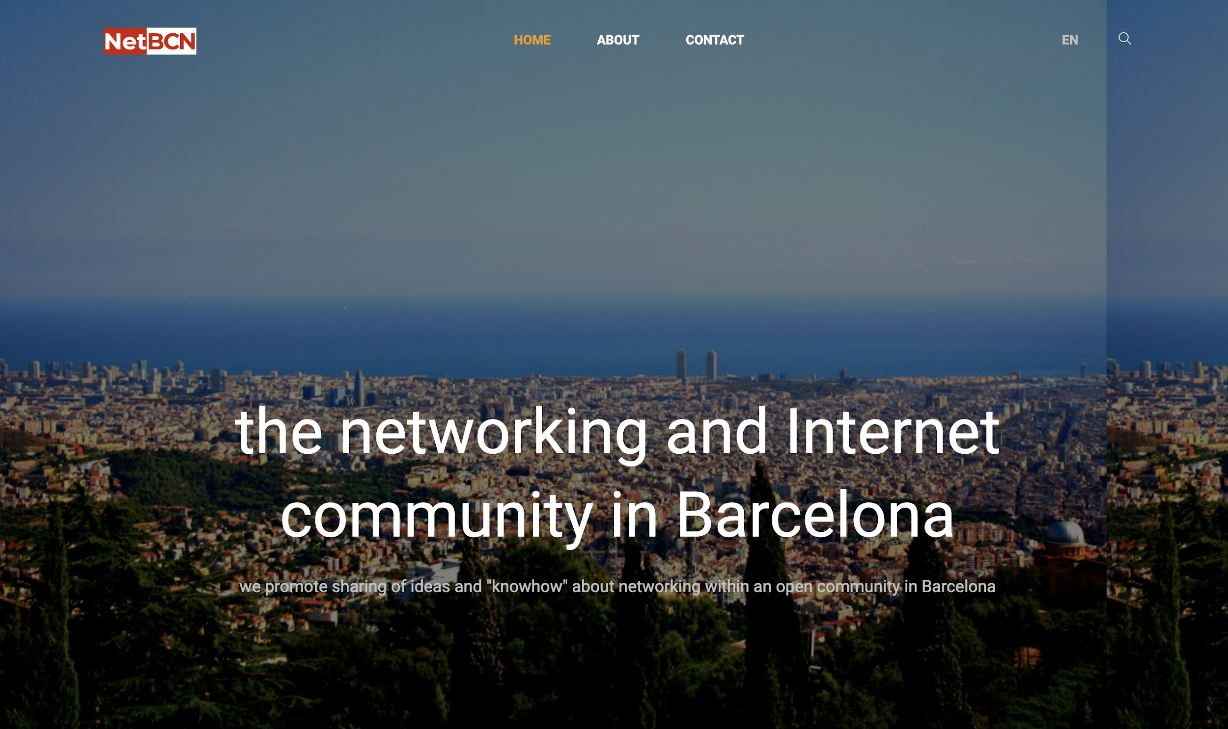

Slide 3
16 events in
3 years

Slide 4
https://www.meetup.com/es-ES/netbcn/
https://netbcn.cat
netbcn.slack.com
we@netbcn.cat

Slide 5
Agenda
"Hybrid Multi-Cloud orchestration " by Sergio Abuin, Arista
"Microservices pattern for network design" by Marco Marzetti, PCCW Global
"Writing scalable and maintainable tooling" by David Barroso, Fastly

Slide 6
Next NetBCN event
DNS over <insert contentious mechanism here> ,
by Colin Petrie, NTT
El lado oscuro de Streaming Telemetry, by Camilo Cardona, NTT
7th of November

Slide 7
TBC during Beer&Talk

