Slide 1
HYBRID MULTICLOUD ORCHESTRATION
ARISTA

Slide 2
DIRECT
3RD PARTY
NATIVE
INTERNET
IPSEC

Slide 3
 | Ansible | Terraform | CloudFormation
Syntax | YAML | HCL / JSON | JSON
State Management | Some | Yes | No
Manage already created resources | Yes | Hard | No
Providers support | +++ | ++ | AWS

Slide 4
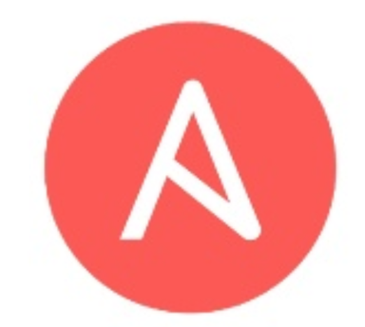
Hybrid Multi-Cloud orchestration

Slide 5
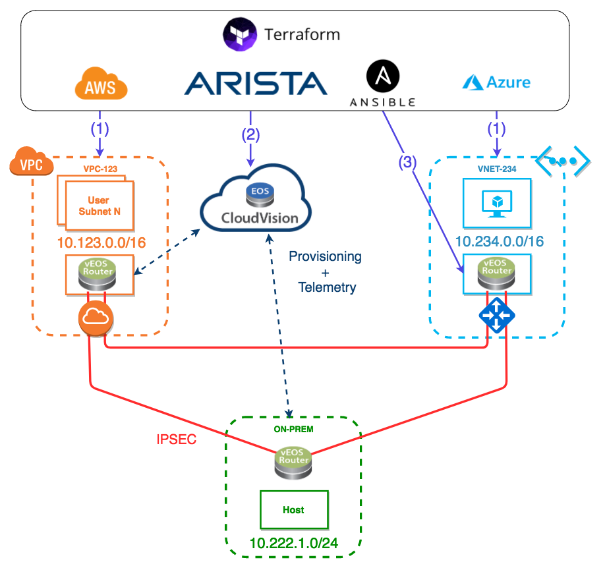
Hybrid Multi-Cloud orchestration
Use Terraform to orchestrate hybrid multi-Cloud deployments
Use CVP API to configure vEOS Routers
Use Ansible to configure vEOS Router (or any third party), integrated into Terraform.

Slide 6
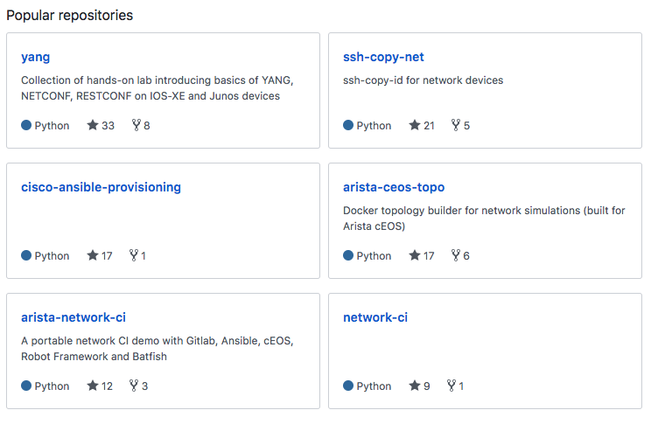
Hybrid Multi-Cloud orchestration demo
https://github.com/networkop/tf-mcloud-demo
A lot more of really good stuff here:
https://github.com/networkop/

Slide 7
Arista CloudVision APIs
CVP API can be used directly using http calls with POST method sending JSON data
RESTful HTTP methods and needed JSON data structures can be found at http://<insert_your_CVP_IP_HERE>/web/api
Can be cumbersome to use the CVP API direct so CVP RAC wrapper is available to simplify
CVP RAC is created and maintained by Arista
CVP RAC exists for several languages like Python, Ruby and GO
Everything that can be done in CVP GUI can be done via the API
https://github.com/aristanetworks/cvprac
https://github.com/networkop/terraform-cvp

Slide 8
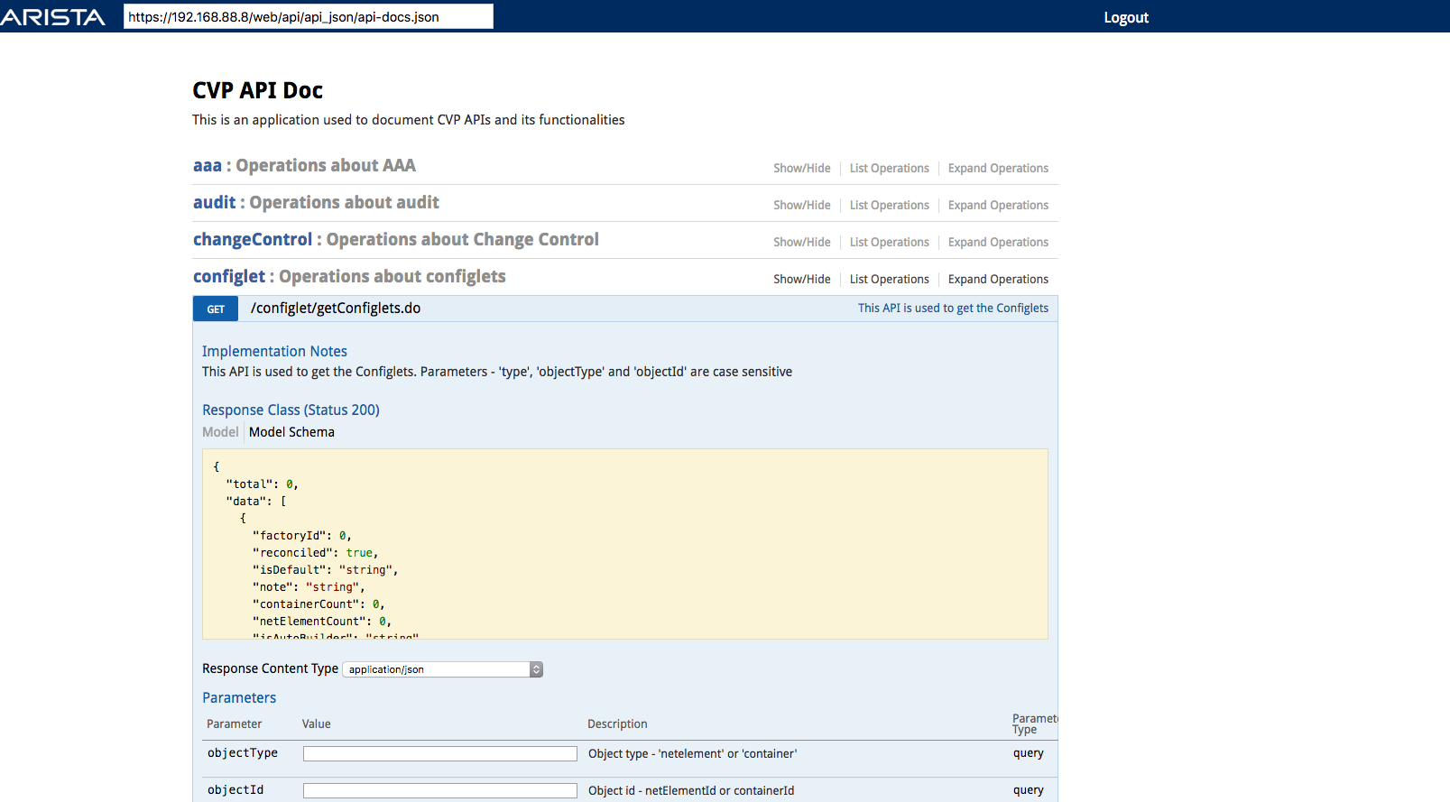
Arista CloudVision APIs

Slide 9
What is Terraform?
Infrastructure as code
A tool to manage virtual server life cycles (AWS, Azure, VMWare, etc.)
A tool to manage supporting services (DNS, Email)
A tool to manage system servies (MySQL, PostgreSQL)
Configuration files can be JSON or HCL (HashiCorp configuration language)
Created by Hashicorp (Vagrant, Vault, et al.)
Written in Go
This is exactly what this demo is about

Slide 10
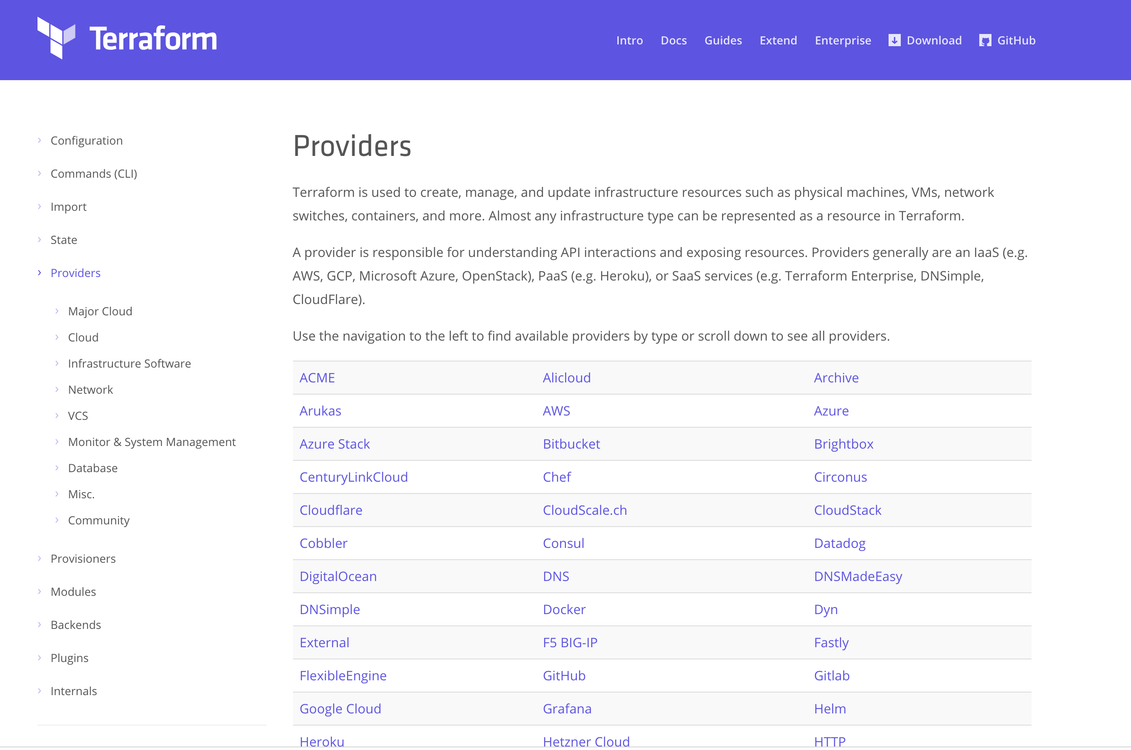
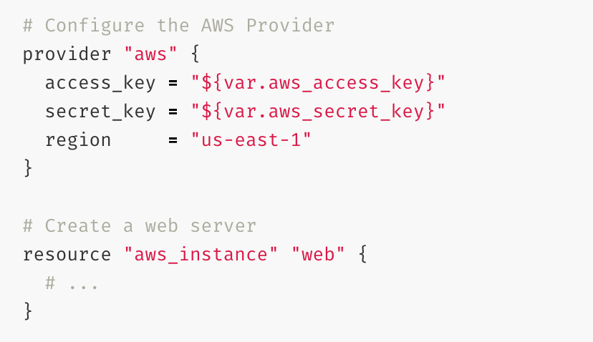
Terraform – Working with resources and providers
https://www.terraform.io/docs/providers/
TYPE
NAME

Slide 11
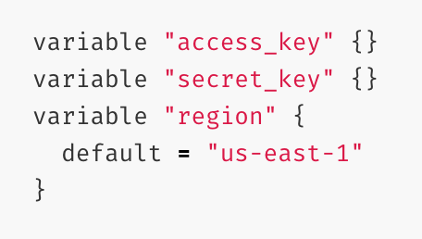
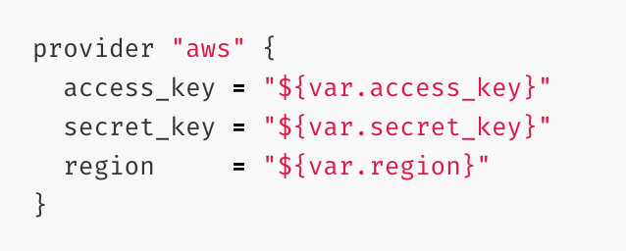
Terraform – Working with variables
Terraform loads all files ending in .tf in a directory
If a default value is set, the variable is optional. Otherwise, the variable is required, so Terraform will prompt you for the values for unset string variables during run time.
Terraform will also read environment variables in the form of TF_VAR_name
variables.tf
Using variables in configuration:
main.tf
Assigning variables from a file:
terraform.tfvars
export TF_VAR_name=“baz”

Slide 12
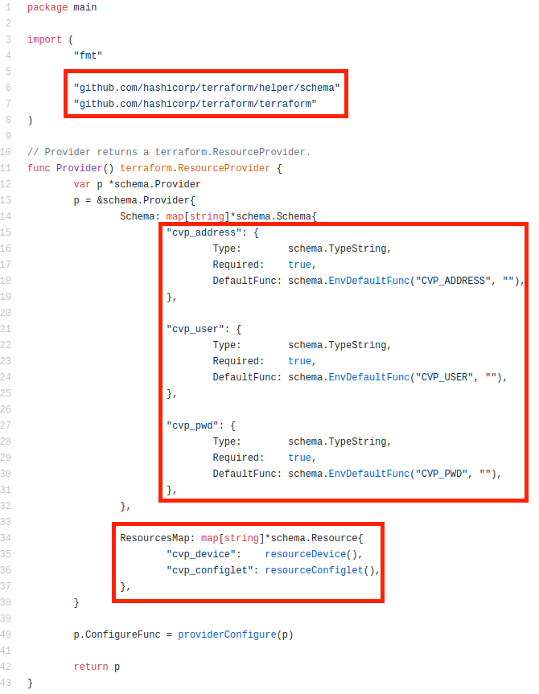
Terraform – CVP
+
https://github.com/networkop/terraform-cvp
https://github.com/networkop/cvpgo

Slide 13
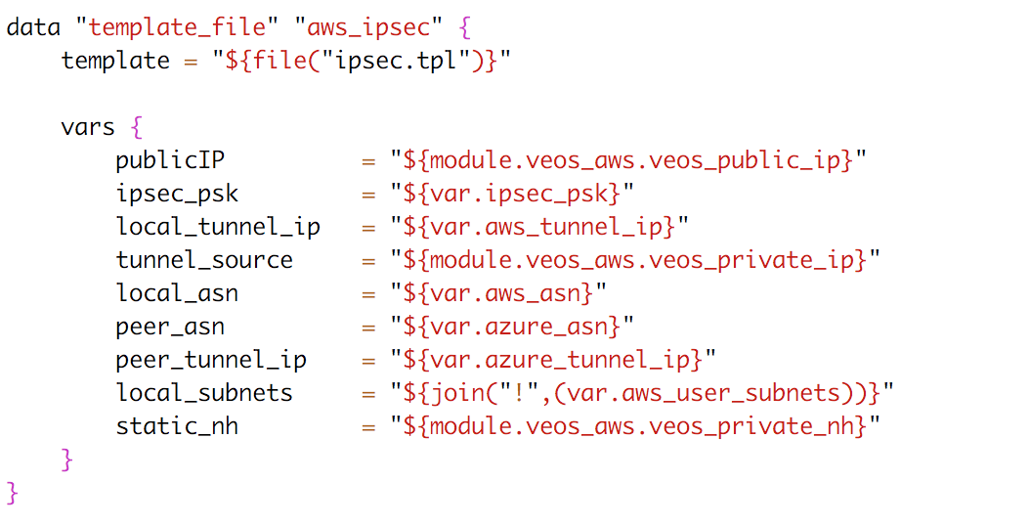
Terraform – CVP resource: Configlet
+
main.tf
ipsec.tpl
…

Slide 14
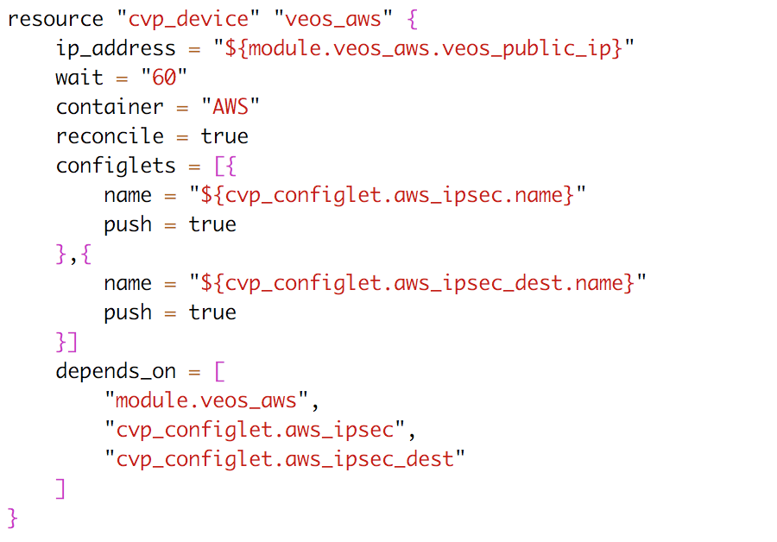
Terraform – CVP resource: Device
Data Center
Campus
Public Cloud
https://github.com/networkop/terraform-cvp

Slide 15
What is Ansible?
Super simple, yet extremely powerful tool to automate software provisioning, configuration management, and application deployment.
Very low barrier for entry, no coding skills needed
Uses SSH or API as transport
Not just for network devices – servers, cloud providers, VMware, whatever
Python based, so easily extended
YAML driven, making it extremely easy to use and is human readable

Slide 16
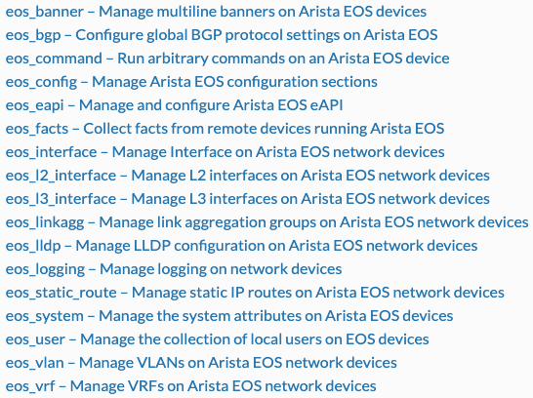
Ansible Modules
1200+ built-in modules including:
apt, yum, copy, command, cron, dns, docker, easy_install, ec2 (amazon modules), file, filesystem, find, git, known_hosts, mysql, mongodb, nagios, npm, openstack, rax (rackspace), pip, shell, snmp_facts, eos_*, cv_*…
eos_* Core Modules
Advantages
No third-party libraries needed
No additional configuraton or client running on the switch
Leverages eAPI/CLI(SSH) connection
Work directly with running-configuration
Easy to use and understand
Offline-mode (generate configuration lines)

Slide 17
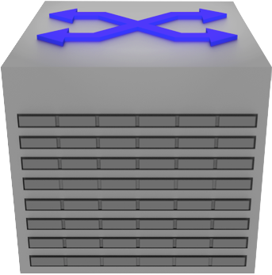
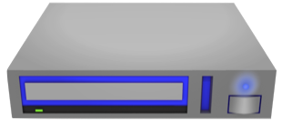
Ansible CVP Integration*
Ansible CVP Module
offering configuration
functionality of devices
Configuration to be sent
can be defined in an
Ansible playbook
(YAML and Jinja templates)
CVP
API
eAPI
Makes delegation of discrete parts of the configuration possible
Change control and rollback achieved when config is sent through CVP
Firm procedure and review possibilities if integration with ServiceNow is used
Gives traceability and audibility through logs in CVP for performed tasks
*NOT USED IN THIS DEMO

Slide 18
“Talk is cheap. Show me the code.”*

Slide 19
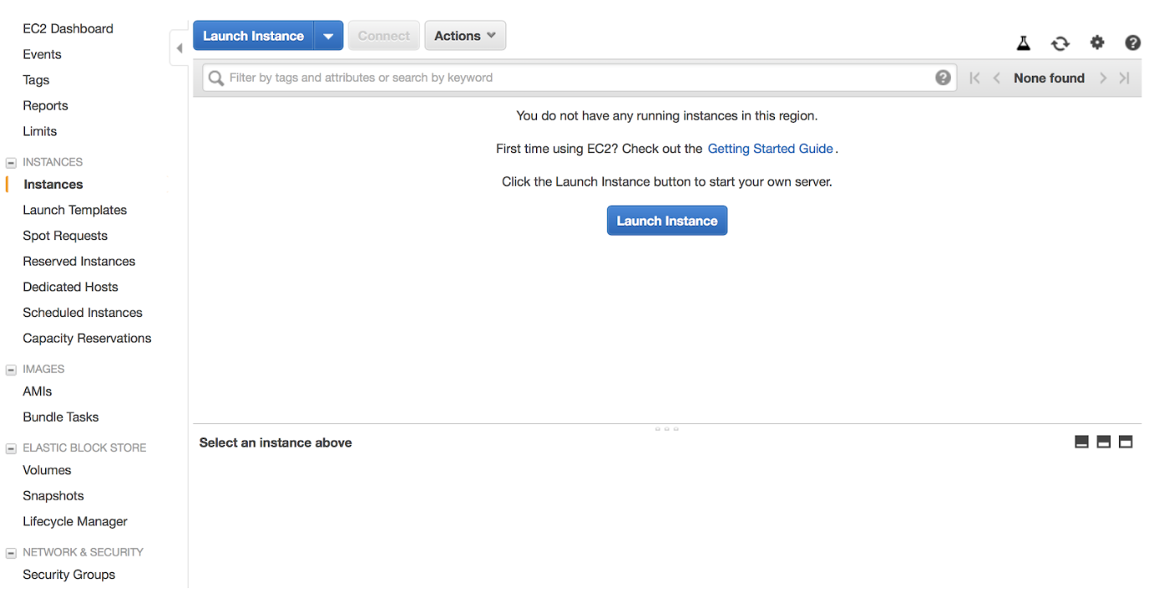

Slide 20
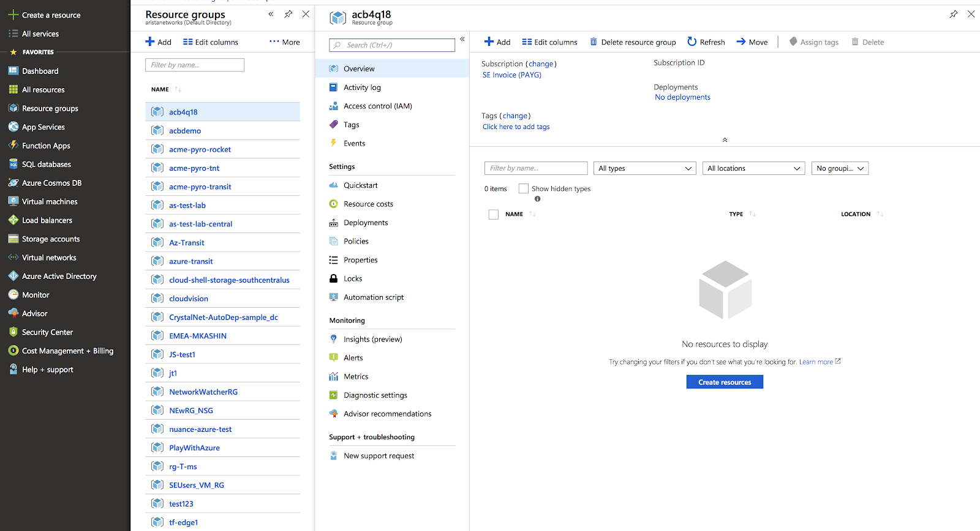

Slide 21
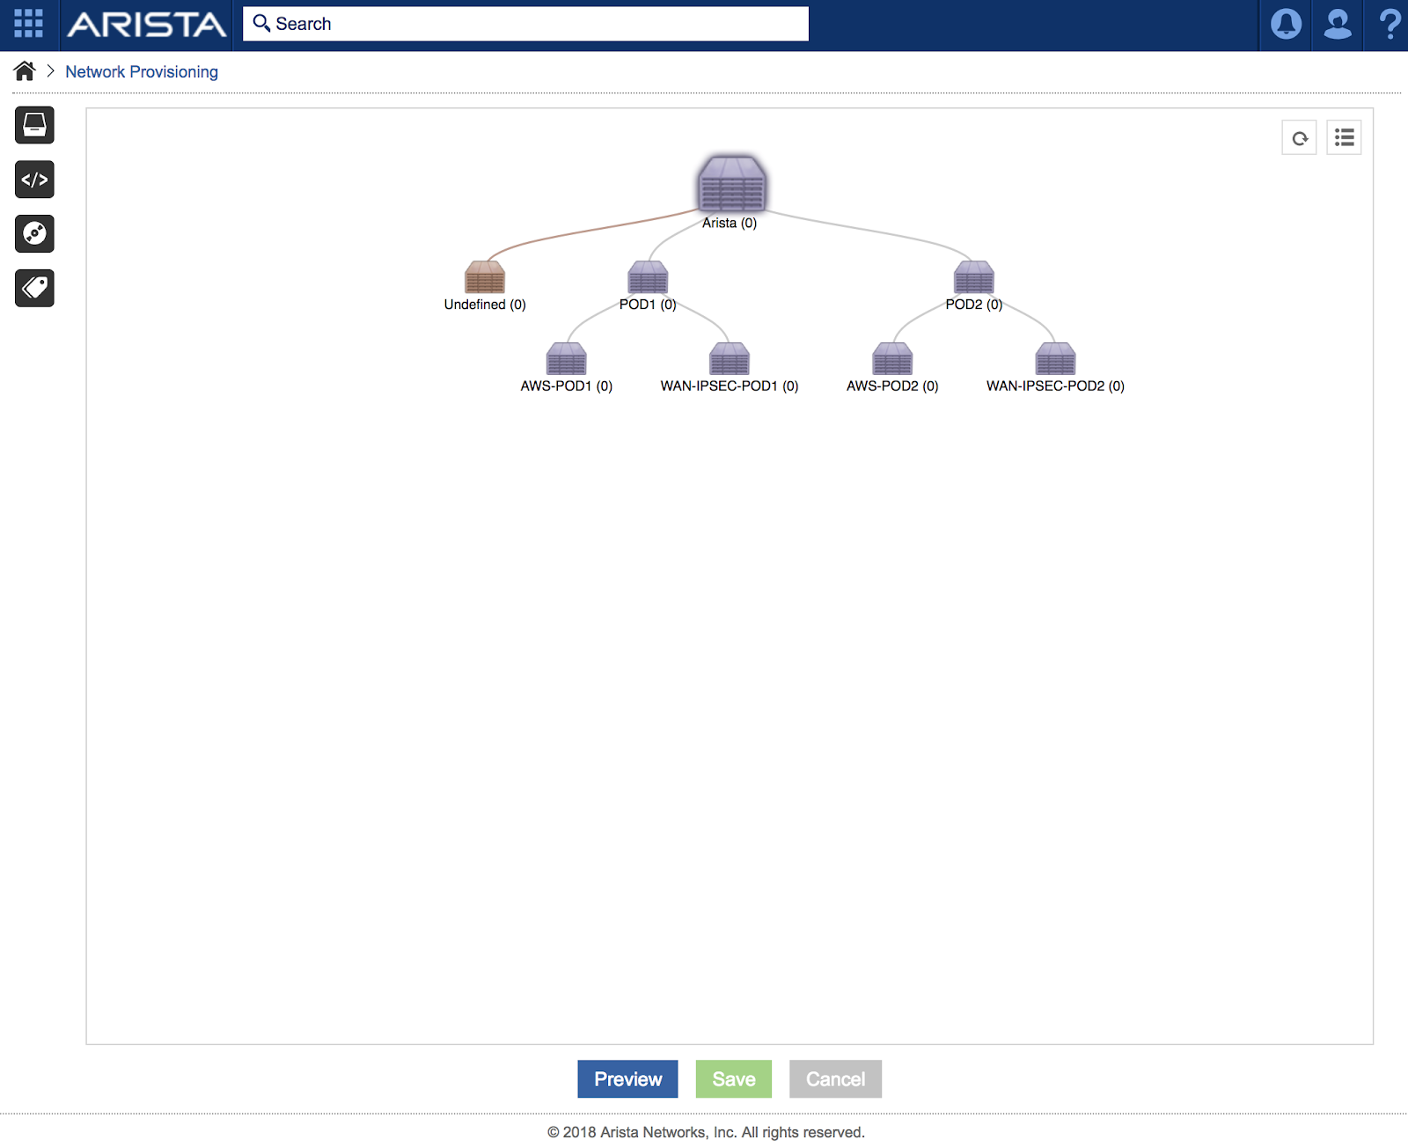
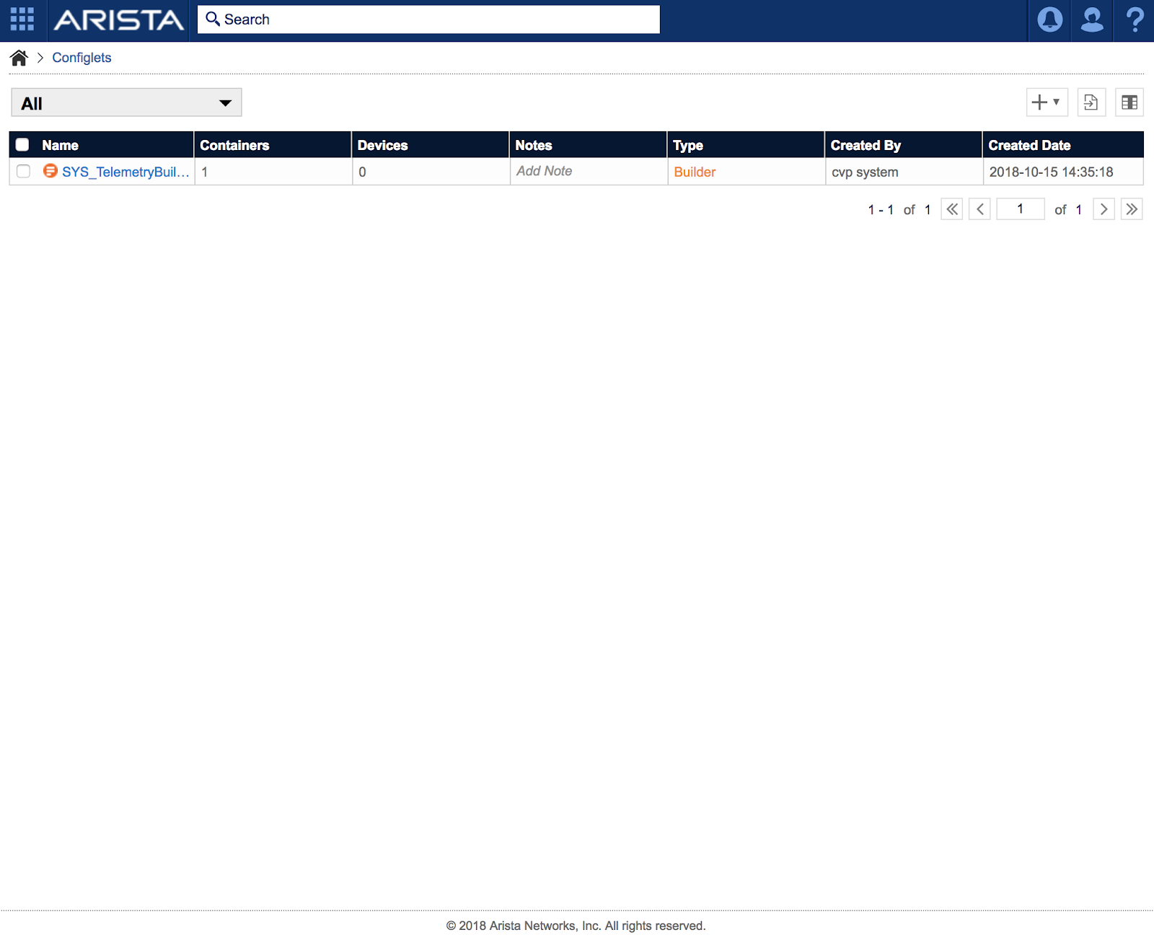

Slide 22
Ok, I’m ready to see some action now…
RUN!
terraform init
terraform apply
terraform destroy

Slide 23
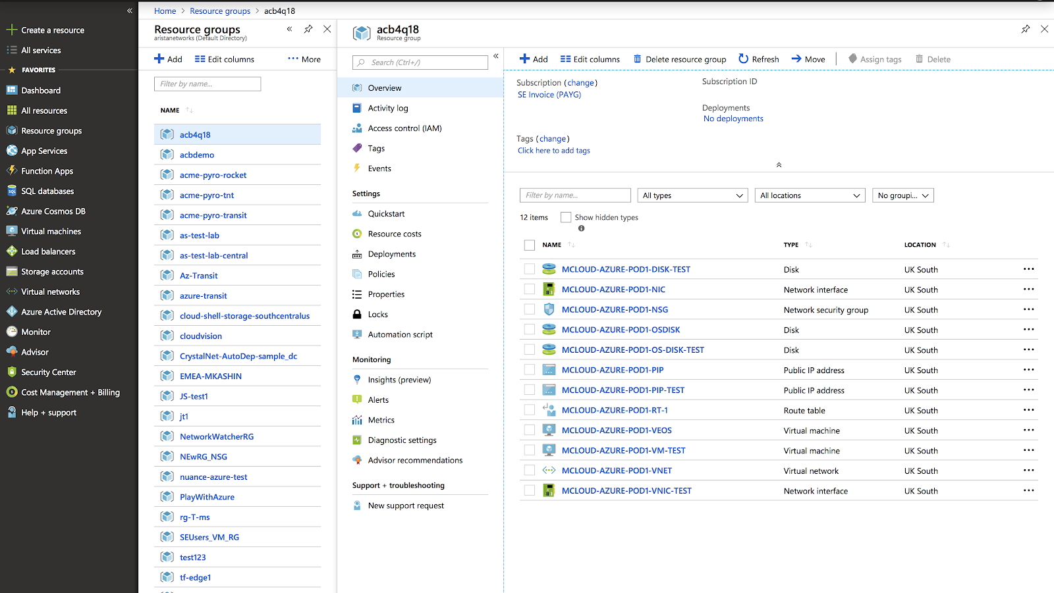

Slide 25
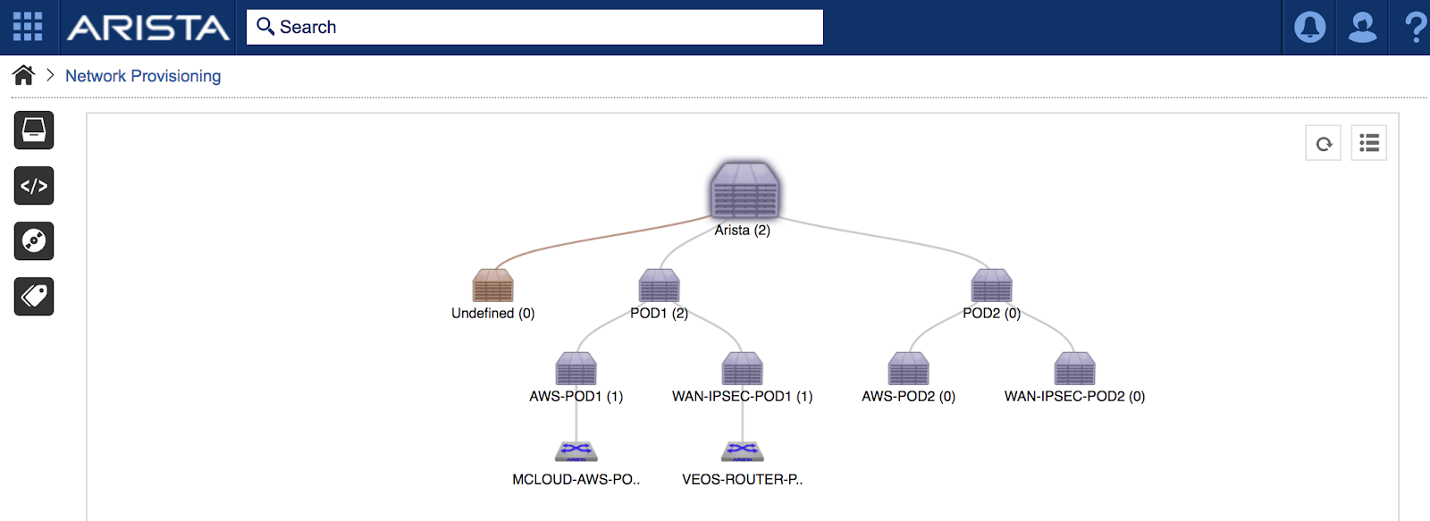
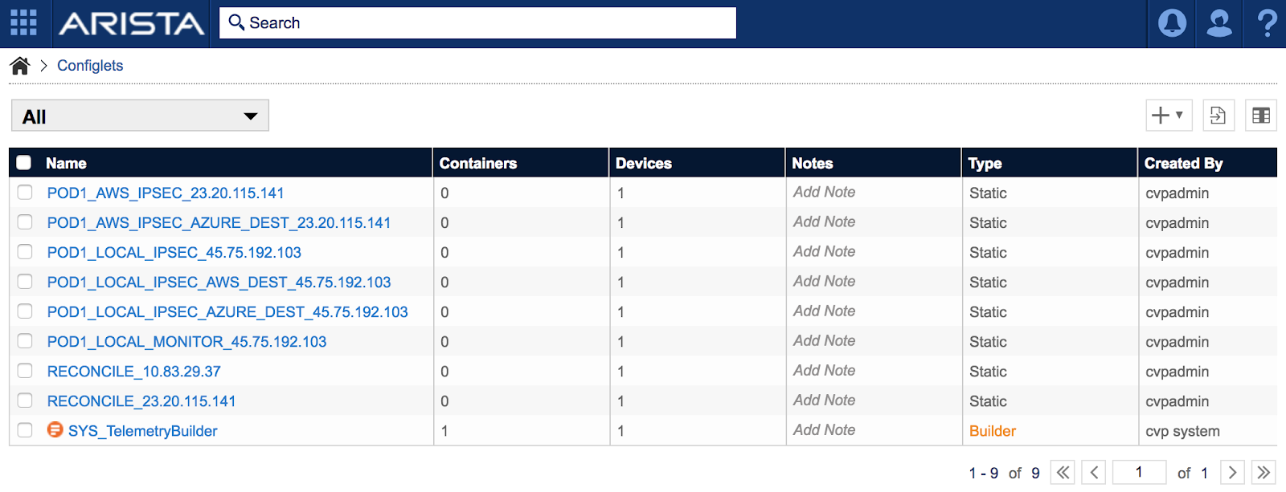

Slide 26
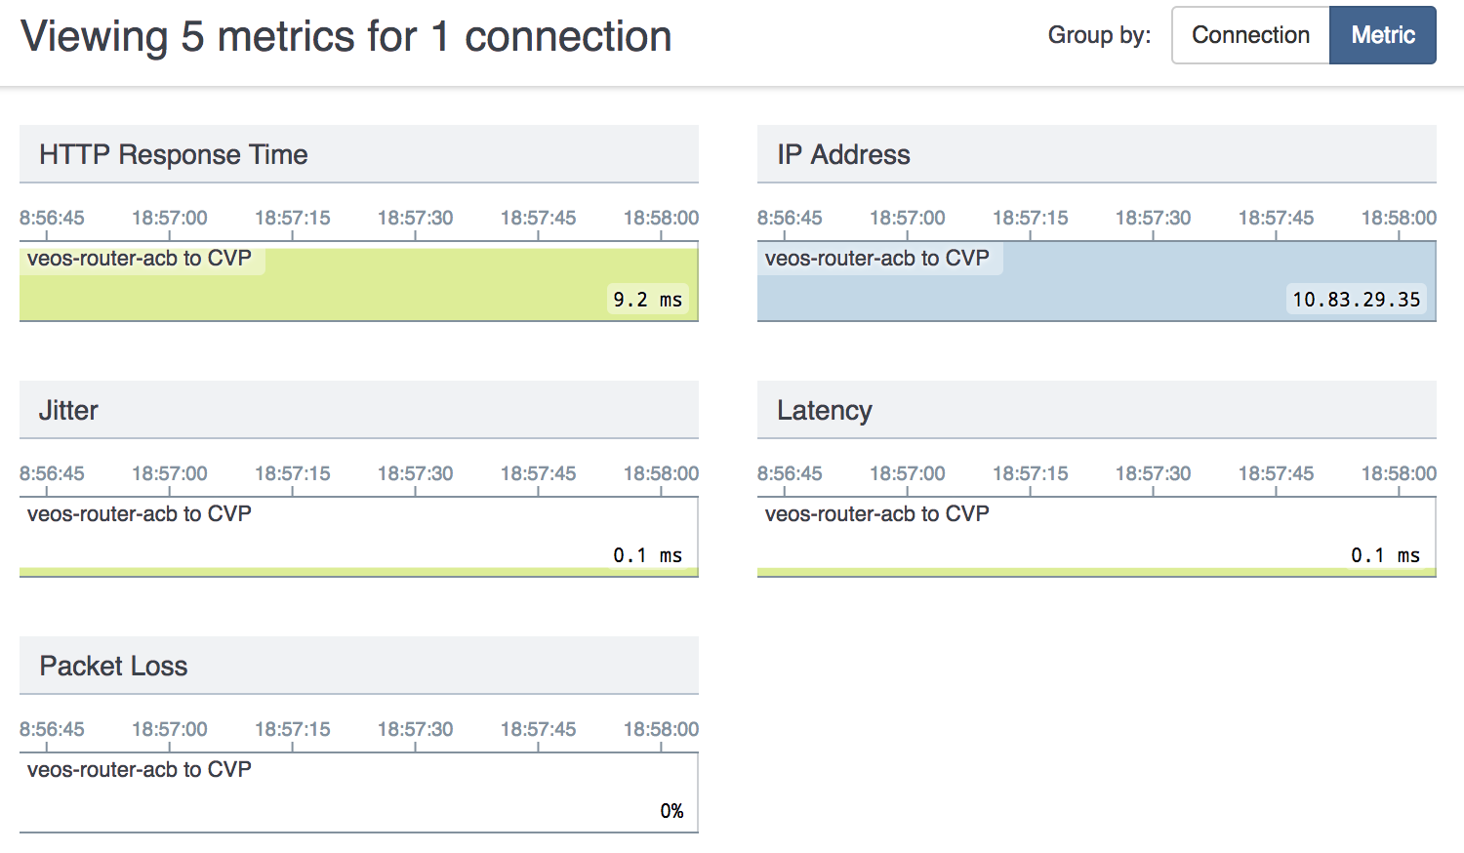

Slide 27
VEOS-ROUTER-POD1#show ip route bgp
VRF: default
Codes: C - connected, S - static, K - kernel,
O - OSPF, IA - OSPF inter area, E1 - OSPF external type 1,
E2 - OSPF external type 2, N1 - OSPF NSSA external type 1,
N2 - OSPF NSSA external type2, B I - iBGP, B E - eBGP,
R - RIP, I L1 - IS-IS level 1, I L2 - IS-IS level 2,
O3 - OSPFv3, A B - BGP Aggregate, A O - OSPF Summary,
NG - Nexthop Group Static Route, V - VXLAN Control Service,
DH - DHCP client installed default route, M - Martian
B E 10.123.1.0/24 [200/0] via 169.254.1.10, Tunnel1
B E 10.123.2.0/24 [200/0] via 169.254.1.10, Tunnel1
B E 10.234.1.0/24 [200/0] via 169.254.2.20, Tunnel2
AWS prefixes
AZURE prefixes

Slide 28
acb@acb4q2018:~/mcloud-pod1$ ping 10.123.1.137
PING 10.123.1.137 (10.123.1.137) 56(84) bytes of data.
64 bytes from 10.123.1.137: icmp_seq=1 ttl=62 time=92.4 ms
64 bytes from 10.123.1.137: icmp_seq=2 ttl=62 time=92.6 ms
64 bytes from 10.123.1.137: icmp_seq=3 ttl=62 time=92.4 ms
64 bytes from 10.123.1.137: icmp_seq=4 ttl=62 time=92.3 ms
64 bytes from 10.123.1.137: icmp_seq=5 ttl=62 time=92.3 ms
^C
--- 10.123.1.137 ping statistics ---
5 packets transmitted, 5 received, 0% packet loss, time 4001ms
rtt min/avg/max/mdev = 92.347/92.468/92.681/0.352 ms
acb@acb4q2018:~/mcloud-pod1$ ping 10.234.1.4
PING 10.234.1.4 (10.234.1.4) 56(84) bytes of data.
64 bytes from 10.234.1.4: icmp_seq=1 ttl=62 time=3.57 ms
64 bytes from 10.234.1.4: icmp_seq=2 ttl=62 time=2.97 ms
64 bytes from 10.234.1.4: icmp_seq=3 ttl=62 time=3.75 ms
64 bytes from 10.234.1.4: icmp_seq=4 ttl=62 time=3.30 ms
^C
--- 10.234.1.4 ping statistics ---
4 packets transmitted, 4 received, 0% packet loss, time 3004ms
rtt min/avg/max/mdev = 2.978/3.403/3.752/0.300 ms

