Slide 1
Excessive BGP AS Path Prepending is a Self-Inflicted Vulnerability
Doug Madory
Oracle Internet Intelligence
ESNOG/GORE 24
BARCELONA

Slide 2
Excessive BGP AS Path Prepending is a Self-Inflicted Vulnerability
Doug Madory, Matt Prosser
Oracle Internet Intelligence
RIPE 79
Rotterdam

Slide 3
What is AS_PATH Prepending?
A technique used to de-prioritize a route by artificially increasing AS_PATH length.
“Prepending” is repeating an ASN in AS_PATH – typically to a subset of adjacent ASes.
… 3356 4192 4192 7160 208.72.91.0/24
Assuming all other criterion are equal, BGP route selection prefers the shorter AS path length (i.e. non-prepended route).
Copyright © 2019, Oracle and/or its affiliates. All rights reserved.

Slide 4
But prepending can also be problematic
Rarely the direct cause of problems, with one notable exception:
Feb 2009: Internet-wide outages caused by a single errant routing announcement. In this incident, AS47868 announced its one prefix with an extremely long AS path. [1,2]
Big difference in MikroTik vs Cisco config
Admin entered ASN instead of prepend count
47868 modulo 256 = 252 prepends
As AS path lengths exceeded 255, Cisco routers crashed
https://dyn.com/blog/the-flap-heard-around-the-world/
https://dyn.com/blog/longer-is-not-better/
Copyright © 2019, Oracle and/or its affiliates. All rights reserved.

Slide 5
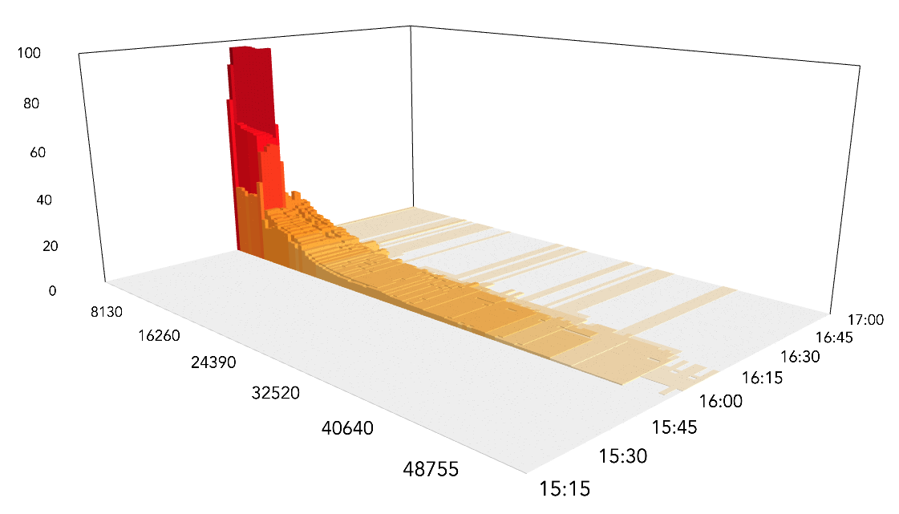
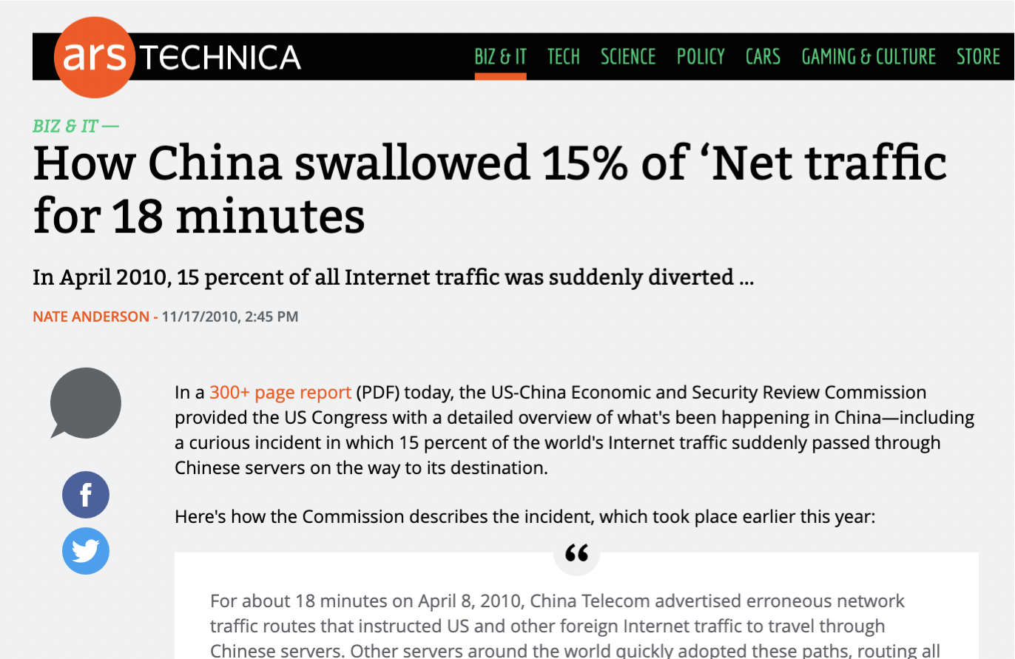
China did not hijack 15% of all internet traffic
Most impact was constrained to Chinese routes.
However, two of the top five most-propagated leaked routes were US routes!
peer percentage (propagation)
prefixes (sorted by max peer percentage)
time (utc)
Copyright © 2019, Oracle and/or its affiliates. All rights reserved.

Slide 6
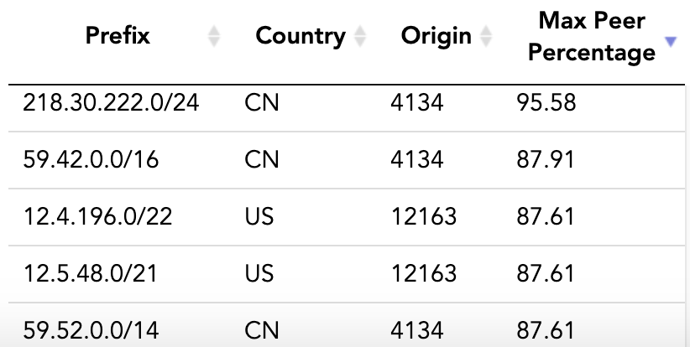
China did not hijack 15% of all internet traffic
Why were two of the most-propagated leaked routes from the US?
We termed this:
hijack me please
I hate myself
prepended-to-all
12.5.48.0/21 and 12.4.196.0/22 were announced to the internet along following excessively prepended AS path:
… 3257 7795 12163 12163 12163 12163 12163 12163
Copyright © 2019, Oracle and/or its affiliates. All rights reserved.

Slide 7
Impacts of Excessive Prepending During Leaks
Much of the worst propagation of leaked routes during big leak events were due to routes being prepended-to-all.
AS4671 leak of April 2014 (>320,000 prefixes)
^ Prepended-to-all
… 2856 7862 7862 7862 7862 7862 146.23.208.0/21
https://dyn.com/blog/indonesia-hijacks-world/
Copyright © 2019, Oracle and/or its affiliates. All rights reserved.

Slide 8
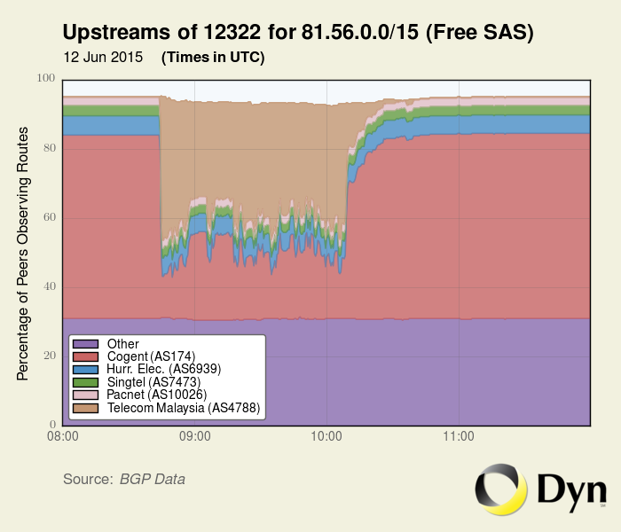
Impacts of Excessive Prepending During Leaks
Much of the worst propagation of leaked routes during big leak events were due to routes being prepended-to-all.
AS4788 leak of June 2015 (>260,000 prefixes)
^ Prepended-to-all
… 174 12322 12322 12322 12322 82.224.0.0/12
https://dyn.com/blog/global-collateral-damage-of-tmnet-leak/
Copyright © 2019, Oracle and/or its affiliates. All rights reserved.

Slide 9
Prepending to Everyone!
Prepended-to-all prefixes are those seen as prepended by all (or nearly all) of the ASes of the internet.
In this configuration, prepending is no longer shaping route propagation.
It is simply incentivizing ASes to choose another origin if one were to suddenly appear whether by mistake or otherwise.
How many prefixes are prepended-to-all? …a lot!
Copyright © 2019, Oracle and/or its affiliates. All rights reserved.

Slide 10
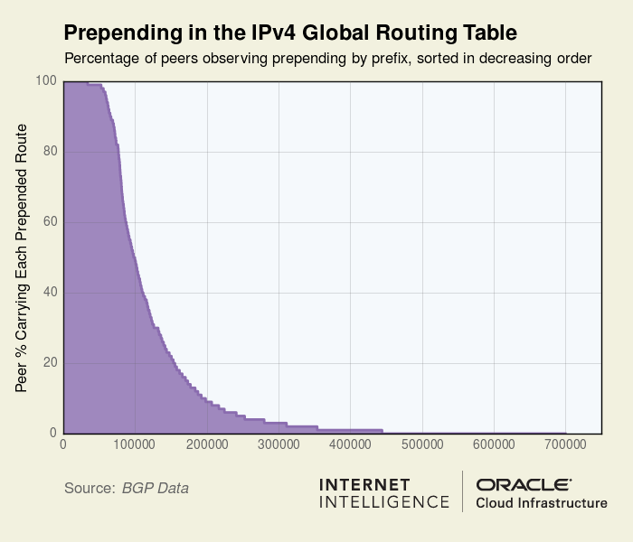
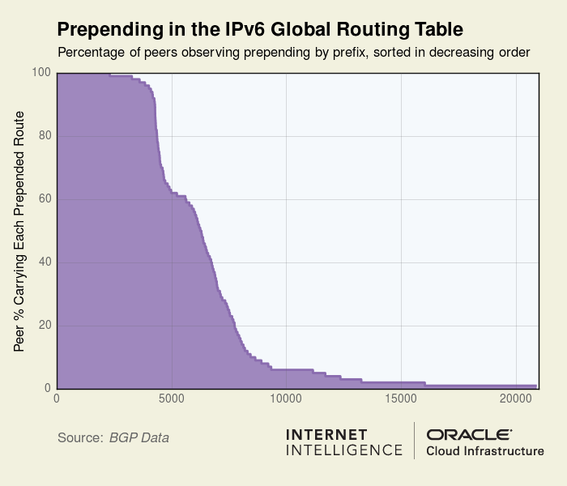
Prepending in the Global Routing Tables
Copyright © 2019, Oracle and/or its affiliates. All rights reserved.

Slide 11
Prepending in the IPv4 Global Routing Table
Prefixes prepended to >95% of ASes: >60k
8% of IPv4 Global Routing Table (1/12)
Includes entities of every stripe: governments, financial institutions, even important parts of internet infrastructure.
Prefixes prepended to >50% of ASes: >100k
13.3% of IPv4 Global Routing Table.
Copyright © 2019, Oracle and/or its affiliates. All rights reserved.

Slide 12
Prepending in the IPv6 Global Routing Table
Prefixes prepended to 95% ASes: >3k
5.6% of IPv6 Global Routing Table
Prefixes prepended to 50% ASes: >6k
8.6% of IPv6 Global Routing Table
Copyright © 2019, Oracle and/or its affiliates. All rights reserved.

Slide 13
Prepending is frequently employed in an excessive manner such that it renders routes vulnerable to disruption or misdirection – accidental or otherwise

Slide 14
What’s the Risk?
On a recent day, 95.47.142.0/23 was “prepended-to-all” like so:
… 3255 197158 197158 197158 197158 197158 197158 197158 197158 197158 197158 197158 197158 197158 197158 197158 197158 197158 197158 197158 197158 197158 197158 197158
An attacker might announce the same prefix with a fabricated AS path like the following:
… ASXXX 3255 197158
Would redirect a portion of traffic to this prefix via ASXXX
Copyright © 2019, Oracle and/or its affiliates. All rights reserved.

Slide 15
What’s the Risk?
The length of prepending gives the attacker room to craft an AS path that would appear plausible, comply with origin validation, and not be detected by off-the-shelf route monitoring.
… 3255 197158 197158 197158 197158 197158 197158 197158 197158 197158 197158 197158 197158 197158 197158 197158 197158 197158 197158 197158 197158 197158 197158 197158
… ASXXX 3255 197158
Copyright © 2019, Oracle and/or its affiliates. All rights reserved.

Slide 16
An inadvertent origin leak could also disrupt traffic to these routes. Accidents happen, so why deliberately put your routes at risk?

Slide 17
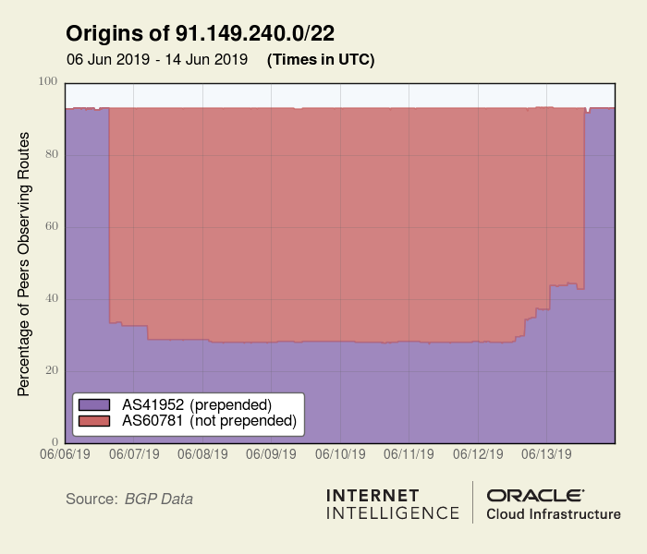
Prepended vs non-prepended in the wild
So what happens when a non-prepended route goes up against an excessively prepended route?
91.149.240.0/22 is a Polish route that is normally announced with the origin prepended three times (“41952 41952 41952”).
AS60781 (not prepended) quickly became the most popular version of this route for the next week until it disappeared.
Copyright © 2019, Oracle and/or its affiliates. All rights reserved.

Slide 18
Prepended vs non-prepended in the wild
Sometimes the impact of prepending isn’t as straightforward.
This prefix is announced to the internet in two ways:
… 174 17356
… 6939 17356 17356 17356 17356 17356 17356 17356 17356 17356 17356 17356
58% of our peers chose prepending 6939 route
42% chose non-prepending 174 routes
Despite prepending, AS6939 is more popular due to extensive peering base of thousands of ASNs.
Copyright © 2019, Oracle and/or its affiliates. All rights reserved.

Slide 19
Is Prepending-To-All a growing problem?
What happens when we run these stats over time? Is there a trend?
Yes! % of IPv4 table that is prepended-to-all is growing at 0.5%/year
IPv6 table is growing slower: 0.2%/year
Copyright © 2019, Oracle and/or its affiliates. All rights reserved.

Slide 20
Why does prepending-to-all happen?
We wanted to know, so we asked some folks doing this. Is it intentional?
... 3356 19256 7955 30321 30321 30321 162.212.148.0/23
We asked Burning Man NetOps about their excessive prepending.
Remove that unnecessary prepending, moonwalker
They immediately fixed it.
Copyright © 2019, Oracle and/or its affiliates. All rights reserved.

Slide 21
Why does prepending-to-all happen?
We wanted to know, so we asked some folks doing this.
CloudFlare, Google also removed the excessive prepending when we reported it to them.
Most either didn’t respond or claimed it was an “operational issue” and it remains.
Copyright © 2019, Oracle and/or its affiliates. All rights reserved.

Slide 22
Why does prepending-to-all happen?
Theory 1: Poor Housekeeping - The AS forgets to remove the prepending for one of its transit providers when it is no longer needed.
Theory 2: Return Path Influence – AS attempting to de-prioritize traffic from transit providers over settlement-free peers.
Copyright © 2019, Oracle and/or its affiliates. All rights reserved.

Slide 23
Why does this happen?
Theory 3: Mistakes Abound - There are simply a lot of errors in BGP routing. Consider the prepended AS path of 181.191.170.0/24 below:
… 52981 267429 267429 267492 267492 267429 267429 267492 267492 267429 267429 267492 267492 267429
In case your eyes didn’t catch it, the prepending here involves a mix of two distinct ASNs (267429 and 267492) with the last two digits transposed.
Copyright © 2019, Oracle and/or its affiliates. All rights reserved.

Slide 24
Conclusions
Long AS paths (whether due to prepending or not) incur risk of disruption
In the event another AS originates the same prefix with a shorter AS path
Network operators should ensure prepending is absolutely necessary
Many of your networks have excessive prepending (ask me for examples)
With 8% of IPv4 and 5.6% of IPv6 global routing tables presently prepended to everyone, this traffic engineering technique is significantly overused.
Copyright © 2019, Oracle and/or its affiliates. All rights reserved.

Slide 25
Thank you
Doug Madory, Matt Prosser
@InternetIntel
Oracle Internet Intel
Copyright © 2019, Oracle and/or its affiliates. All rights reserved.

Slide 26
Safe harbor statement
The following is intended to outline our general product direction. It is intended for information purposes only, and may not be incorporated into any contract. It is not a commitment to deliver any material, code, or functionality, and should not be relied upon in making purchasing decisions.
The development, release, timing, and pricing of any features or functionality described for Oracle’s products may change and remains at the sole discretion of Oracle Corporation.
Copyright © 2019, Oracle and/or its affiliates. All rights reserved.

